Slide 1
Reproducibility in mass spectrometry-based proteomics database searches
Iryna Abramchuk
BCH8166 - November 1, 2023

Slide 2
Mass spectrometer
Digestion
Separation
Mass Analyzer
Mass Analyzer
Liquid Chromatography
Fragmentation
Ionization
(peptide ion)
Proteins
Peptides
MS1 Spectrum
MS2 Spectrum

Slide 3
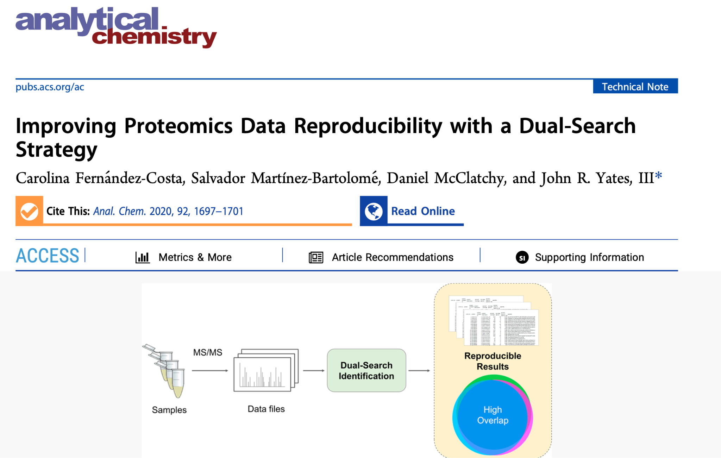
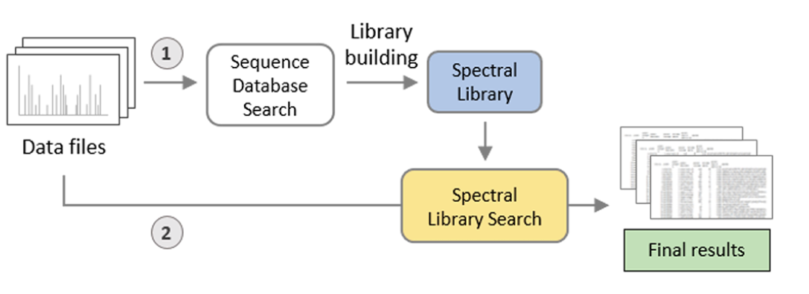
Mass spectrometer
Digestion
Separation
Mass Analyzer
Mass Analyzer
Liquid Chromatography
Fragmentation
Ionization
(peptide ion)
Proteins
Peptides
MS1 Spectrum
MS2 Spectrum
Dual Search Strategy

Slide 4
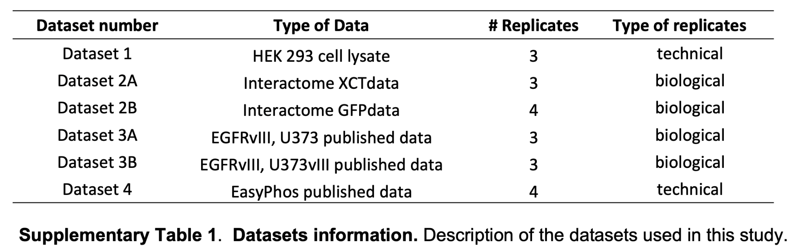

Database search
Compare overlap between replicates in each dataset
Dataset
Spectral library search
Dual search

Slide 5
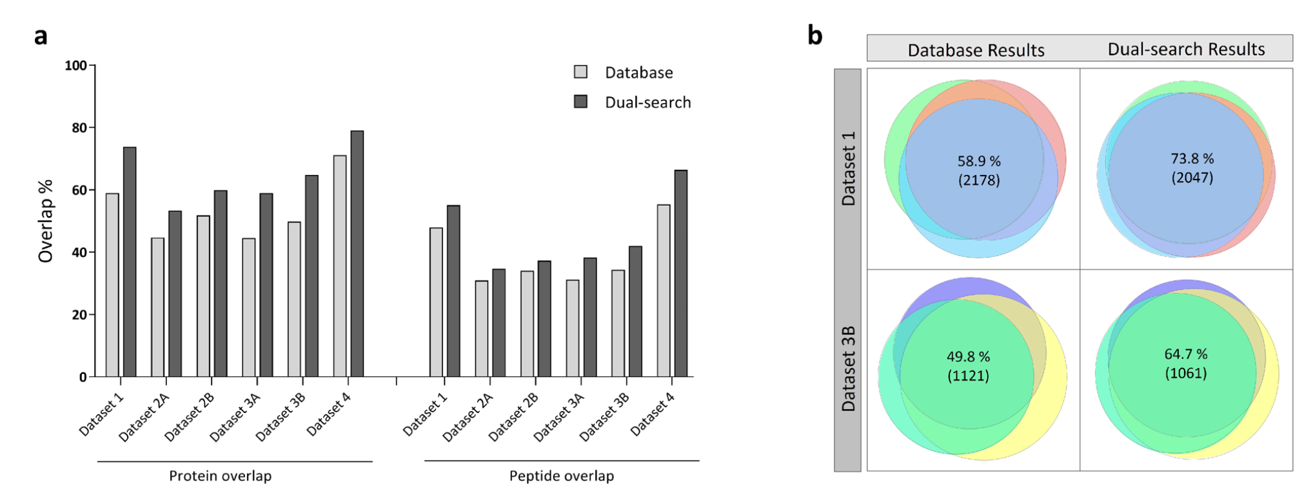
Using the dual search strategy, there is more reproducibility between the proteins/peptides identified across replicate experiments
1. Dual search = more reproducibility among replicates than database search (% and absolute numbers)
2. More overlap between technical replicates than biological replicates

Slide 6
Review of goals
Use Datasets 3 and 4 to check the automated workflow (look for extremely similar, but maybe not identical results)
Recreate analysis
Create an automated workflow for a dual-search (Nextflow, Docker)
Install and use their PaCOM visualization tool (Github) for figures
Recreate analysis for their 4 datasets (check data availability, methods)
Compare results (likely for the protein overlap, if time also for quantification and search space)
Apply workflow to additional datasets
Compile heterogenous proteomics datasets (different instruments, yields, experiments)
Run automated dual-search -> PACOM and compare effect on reproducibility
Notes:
#Methods
1. Recreate analysis
- Set up workflow to automate dual-search strategy
- Install PACOM visualization tool
- Download and run dual-search on 4 datasets used
- Compare figures and results (from dual-search strategy only, not additional quantification reproducibility and search space analyses)
2. Apply workflow to additional datasets
- Compile heterogenous set of datasets (different instruments, experiments, yield sizes)
- Run dual-search, run PACOM
- Same effect? (i.e. increased reproducibility)
Additional thoughts
- Try Snakemake or Nextflow
- Try Docker? Might not be applicable to this
- Potential add-on for step 1: recreate dual-search strategy in a git+snakemake+docker pipeline so it is automated and ready to go for the next time I want to use it

Slide 7
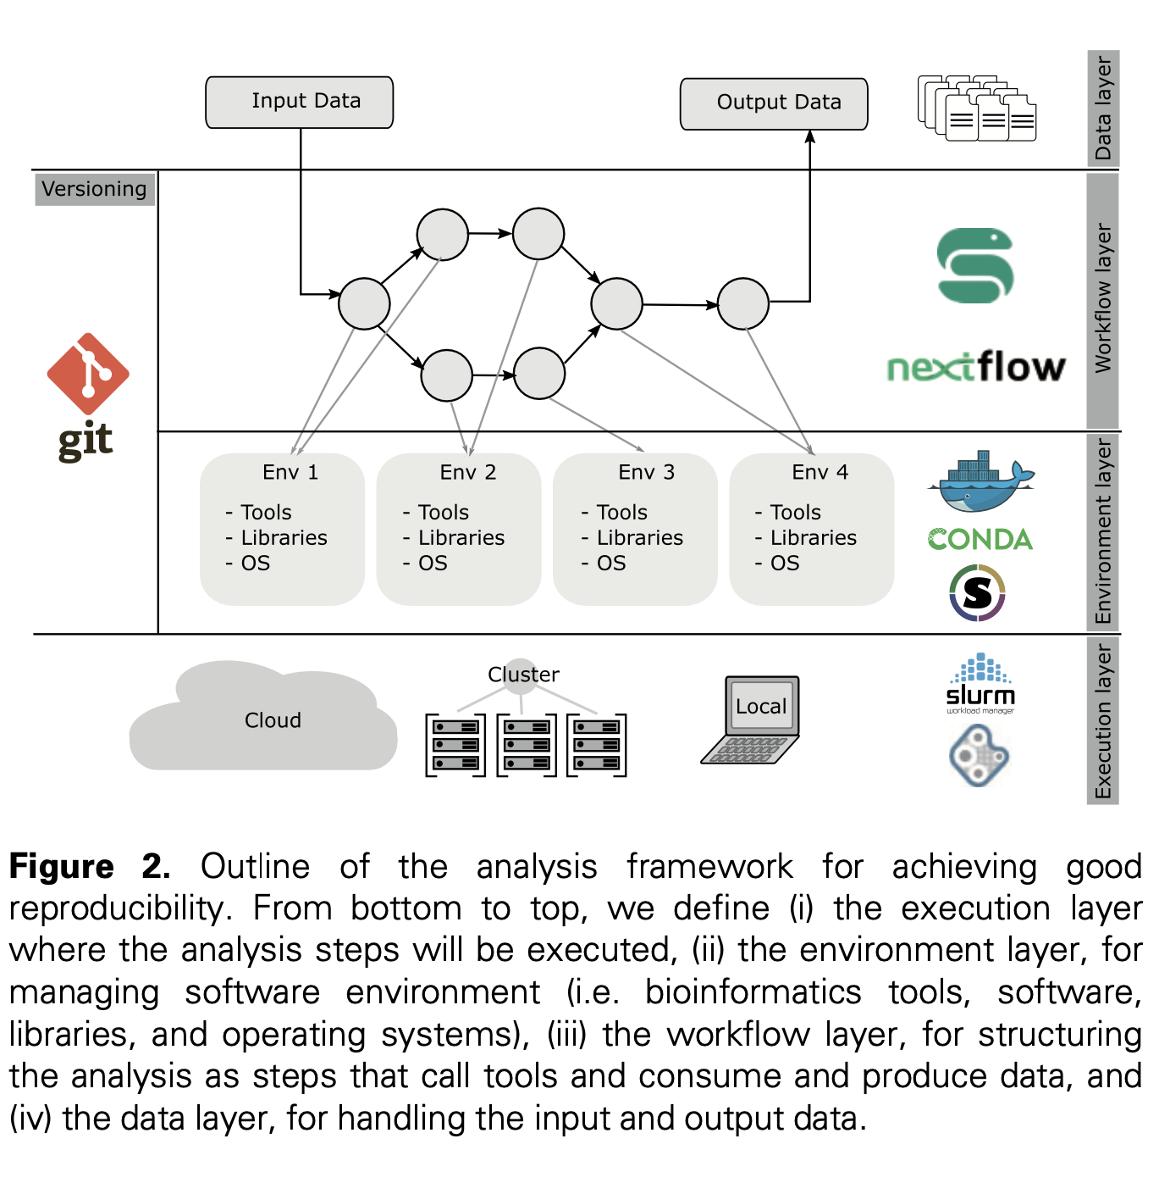
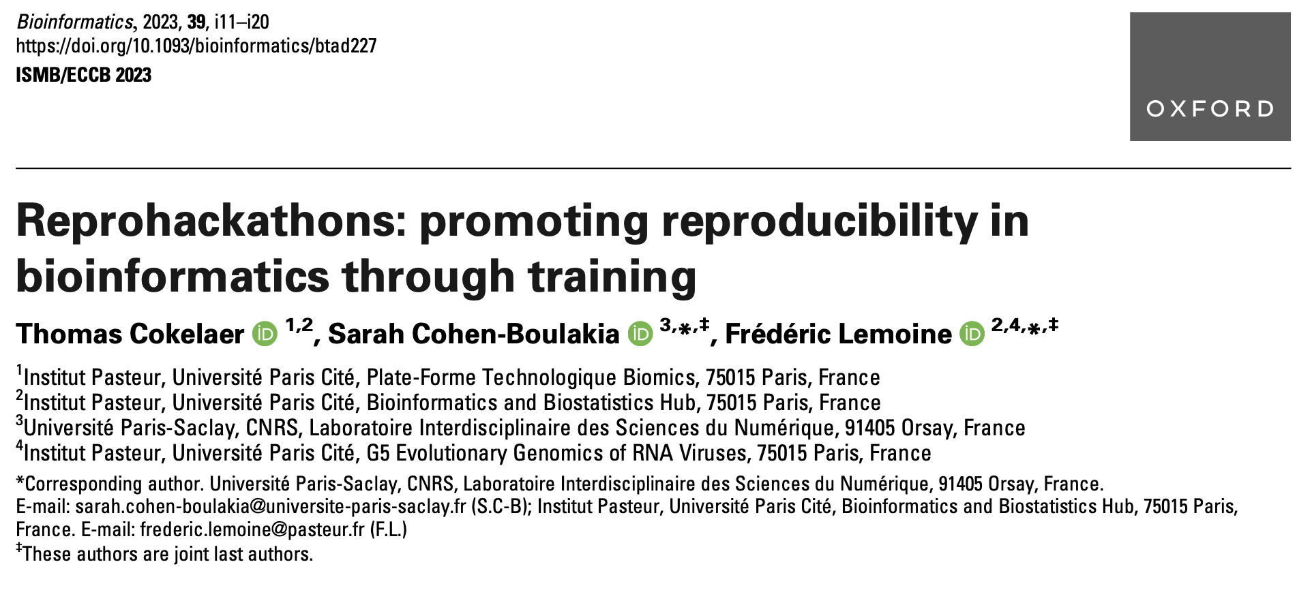

Slide 8


Data layer
Workflow management
Versioning management
Environment layer
Execution layer
git (& GitHub) repo

Slide 9
Data layer
Input data
Output data
.raw files
.fasta database
.params comet, spectraST
.params for each process
.pep.xml, prot.xml database search results
.pep.xml, prot.xml spectral library search results
.txt quick stats of overlap
Workflow management
Versioning management
Environment layer
Execution layer
git (& GitHub) repo
Notes:
11:35

Slide 10


Data layer
Input data
Output data
.raw files
.fasta database
.params comet, spectraST
.params for each process
.pep.xml, prot.xml database search results
.pep.xml, prot.xml spectral library search results
.txt quick stats of overlap
Database search
Create spectral library
Spectral library search
rawconverter (v1.1.0.19)
decoyFASTA or msstitch (?)
comet (from TPP v5.2.0)
peptideprophet (from TPP v5.2.0)
spectrast -create (v5.0)
spectrast -search (v5.0)
peptideprophet (from TPP v5.2.0)
Summary stats
quickstats
Workflow management
Versioning management
Environment layer
Execution layer
git (& GitHub) repo

Slide 11

Data layer
Input data
Output data
.raw files
.fasta database
.params comet, spectraST
.params for each process
.pep.xml, prot.xml database search results
.pep.xml, prot.xml spectral library search results
.txt quick stats of overlap
Database search
Spectral library search
Create spectral library
Mac OS X
rawconverter (v1.1.0.19)
decoyFASTA or msstitch (?)
comet (from TPP v5.2.0)
peptideprophet (from TPP v5.2.0)
spectrast -create (v5.0)
spectrast -search (v5.0)
peptideprophet (from TPP v5.2.0)
Proteomics search tools
Summary stats
quickstats
Windows
Workflow management
Workflow management
Versioning management
Environment layer
Execution layer
git (& GitHub) repo

Slide 12

Data layer
Input data
Output data
.raw files
.fasta database
.params comet, spectraST
.params for each process
.pep.xml, prot.xml database search results
.pep.xml, prot.xml spectral library search results
.txt quick stats of overlap
Database search
Create spectral library
Spectral library search
rawconverter (v1.1.0.19)
decoyFASTA or msstitch (?)
comet (from TPP v5.2.0)
peptideprophet (from TPP v5.2.0)
spectrast -create (v5.0)
spectrast -search (v5.0)
peptideprophet (from TPP v5.2.0)
Summary stats
quickstats
Workflow management
Versioning management
Environment layer
Execution layer
git (& GitHub) repo
WSL2 (Windows Subsystem for Linux)
Ubuntu 20.04.6

Slide 13

Data layer
Input data
Output data
.raw files
.fasta database
.params comet, spectraST
.params for each process
.pep.xml, prot.xml database search results
.pep.xml, prot.xml spectral library search results
.txt quick stats of overlap
Database search
Create spectral library
Spectral library search
rawconverter (v1.1.0.19)
decoyFASTA or msstitch (?)
comet (from TPP v5.2.0)
peptideprophet (from TPP v5.2.0)
spectrast -create (v5.0)
spectrast -search (v5.0)
peptideprophet (from TPP v5.2.0)
Summary stats
quickstats
Workflow management
Versioning management
Environment layer (Docker)
Execution layer
git (& GitHub) repo
spctools/tpp:version5.2
(built on BioContainers Ubuntu image)
WSL2 (Windows Subsystem for Linux)
Ubuntu 20.04.6

Slide 14
Data layer
Input data
Output data
.raw files
.fasta database
.params comet, spectraST
.params for each process
.pep.xml, prot.xml database search results
.pep.xml, prot.xml spectral library search results
.txt quick stats of overlap
Database search
Create spectral library
Spectral library search
rawconverter (v1.1.0.19)
decoyFASTA or msstitch (?)
comet (from TPP v5.2.0)
peptideprophet (from TPP v5.2.0)
spectrast -create (v5.0)
spectrast -search (v5.0)
peptideprophet (from TPP v5.2.0)
Summary stats
quickstats
Workflow management
Versioning management
Environment layer (Docker)
Execution layer
git (& GitHub) repo
spctools/tpp:version5.2
(built on BioContainers Ubuntu image)
WSL2 (Windows Subsystem for Linux)
Ubuntu 20.04.6

Slide 15
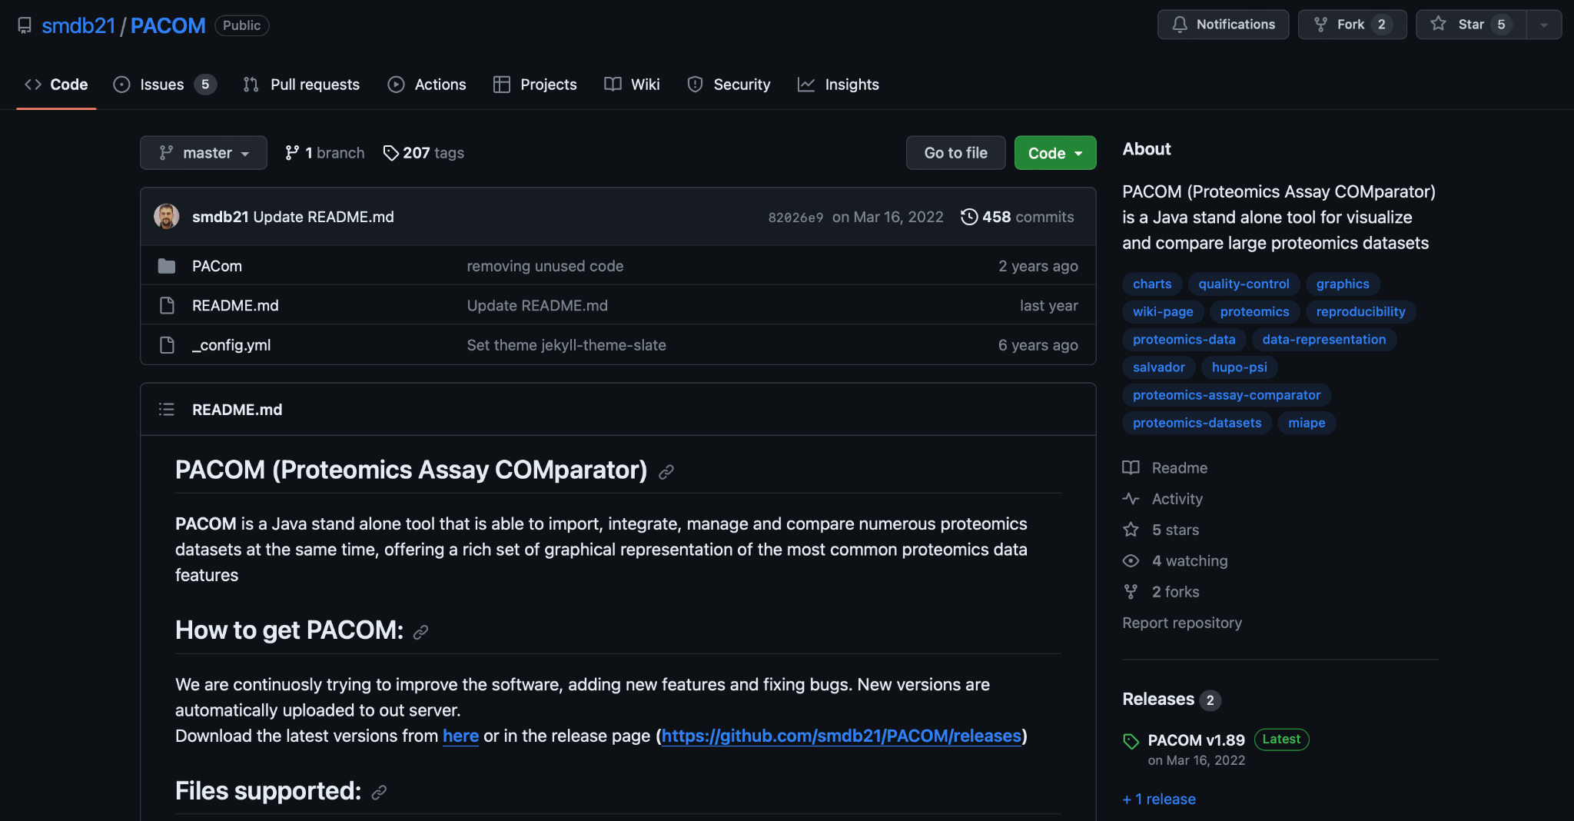
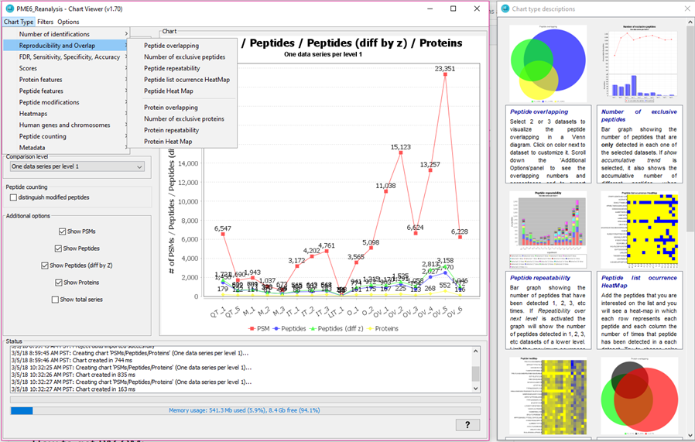
PaCOM visualization tool

Slide 16
Manual comparison (not in automated workflow)
Automated workflow = a lot of new variables for me
Nextflow (extension of Groovy language)
Docker images
Using WSL2
Spectral library searching

Slide 17
Manual comparison (not in automated workflow)
Automated workflow = a lot of new variables for me
Nextflow (extension of Groovy language)
Docker images
Using WSL2
Spectral library searching
Use TPP GUI/bash scripts on local Windows
Parameters/software versions
Explore PaCOM tool
Compare to original analysis

Slide 18
Manual comparison (not in automated workflow)
Automated workflow = a lot of new variables for me
Nextflow (extension of Groovy language)
Docker images
Using WSL2
Spectral library searching
Use TPP GUI/bash scripts on local Windows
Parameters/software versions
Explore PaCOM tool
Compare to original analysis

Slide 19
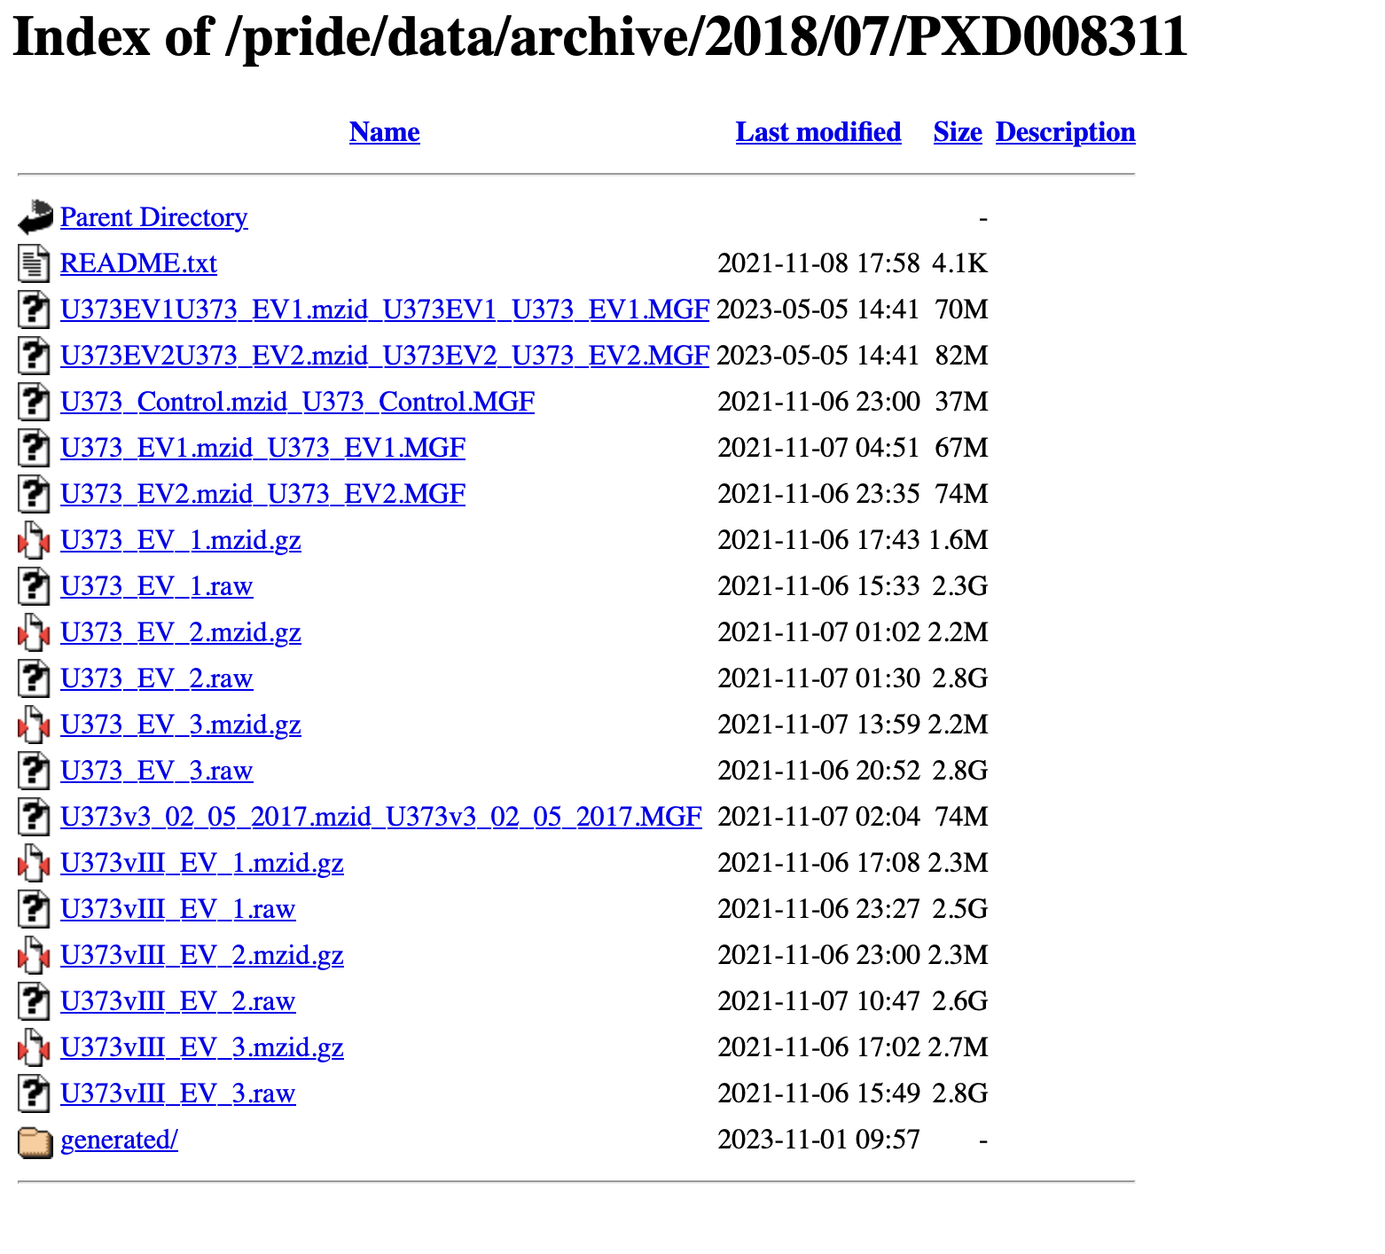
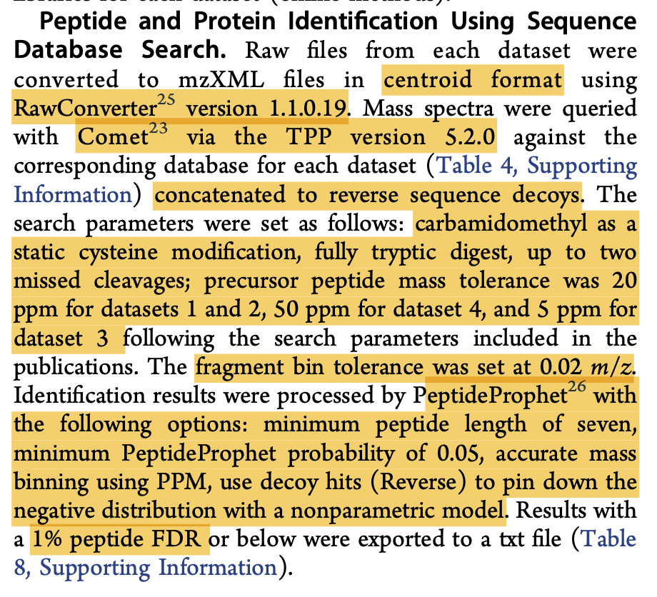
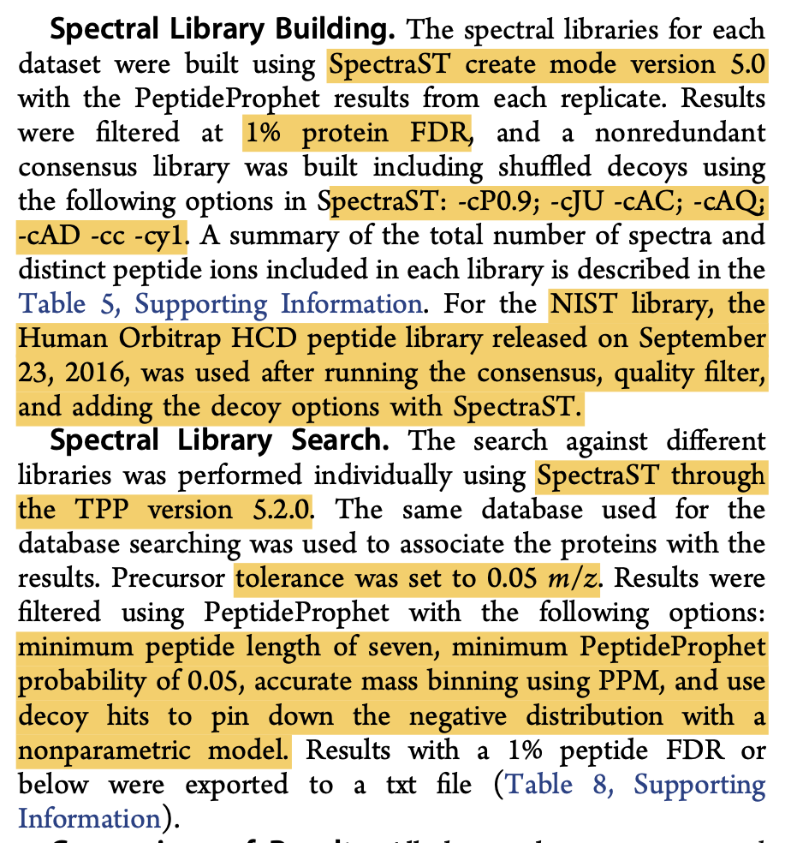
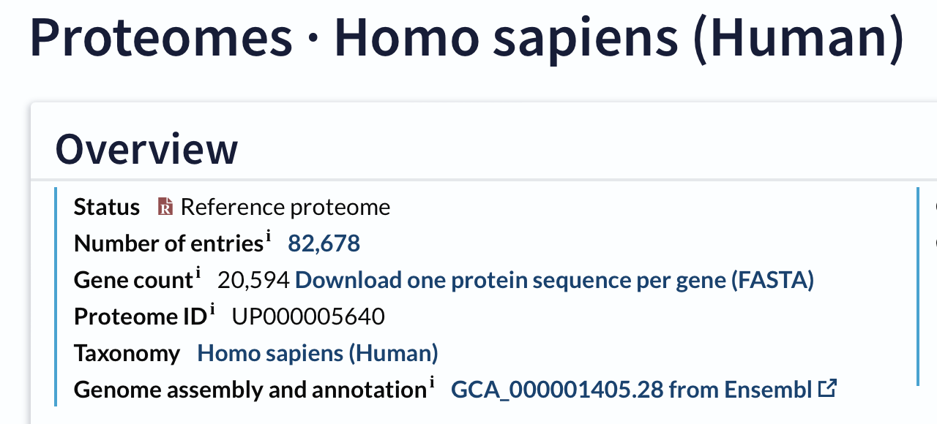
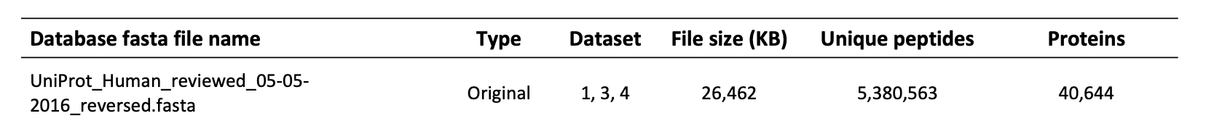
Method/data completeness
Raw data ✓✓✓
Parameters ✓✓
Database ✓
20,322 proteins; 20,322 decoys

Slide 20
The number of peptide-spectrum matches, number of peptides and number of proteins identified at each stage are different, but similar
 |  | Database search |  |  | Dual search
 | Sample | PSM | Peptides | Proteins | PSM | Peptides | Proteins
Reproduced results (IA) | Rep 1 | 8025 | 6121 | 1393 | 7068 | 5505 | 1276
 | Rep 2 | 16172 | 6792 | 1586 | 13330 | 5945 | 1401
 | Rep 3 | 14228 | 6729 | 1578 | 12387 | 5998 | 1420
Fernández-Costa et al (OG) | Rep 1 | 8614 | 6324 | 1409 | 8604 | 5807 | 1167
 | Rep 2 | 17066 | 6681 | 1588 | 19105 | 6297 | 1329
 | Rep 3 | 15327 | 6578 | 1559 | 16772 | 6204 | 1323

Slide 21
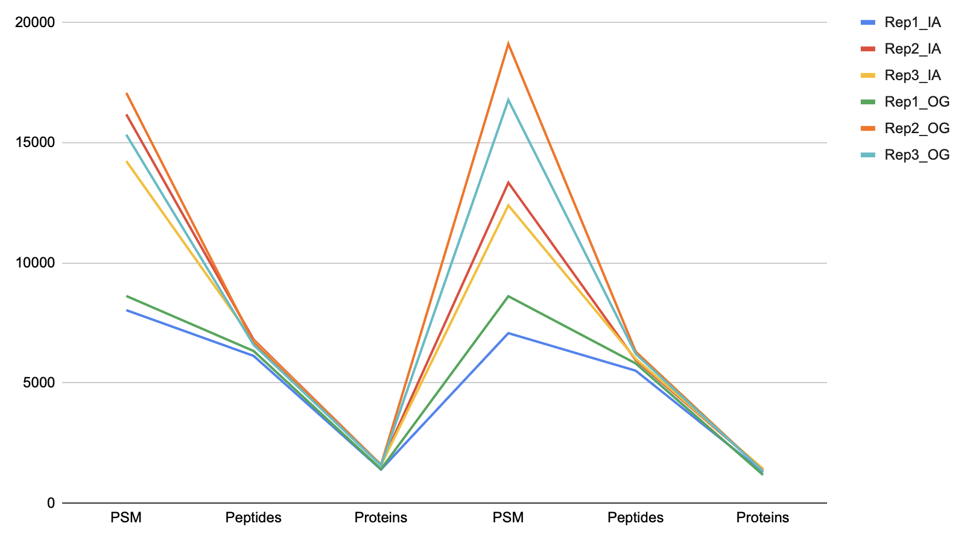
The number of peptide-spectrum matches, number of peptides and number of proteins identified at each stage are different
Database search
Dual search

Slide 22
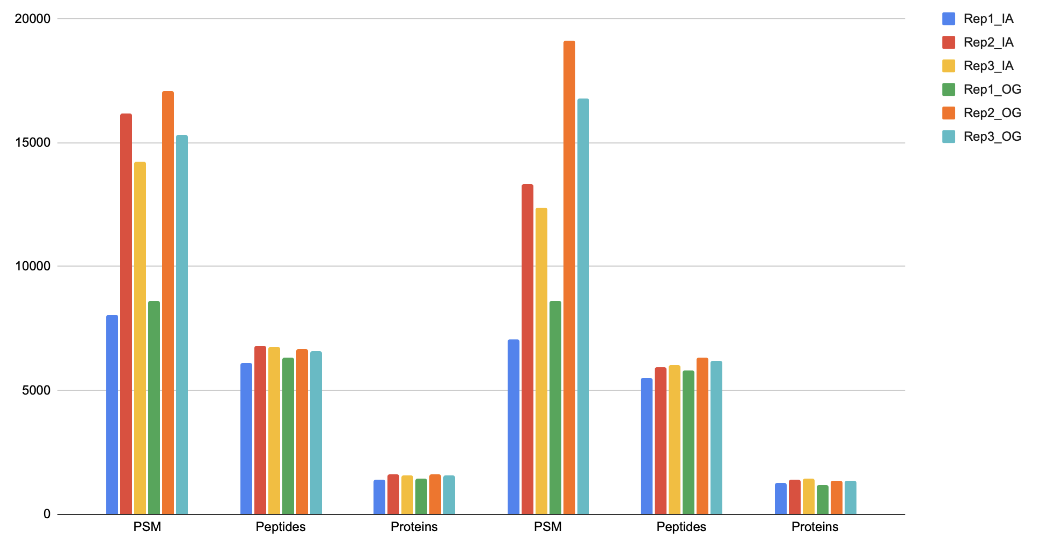
The number of peptide-spectrum matches, number of peptides and number of proteins identified at each stage are different, but similar
Database search
Dual search

Slide 23
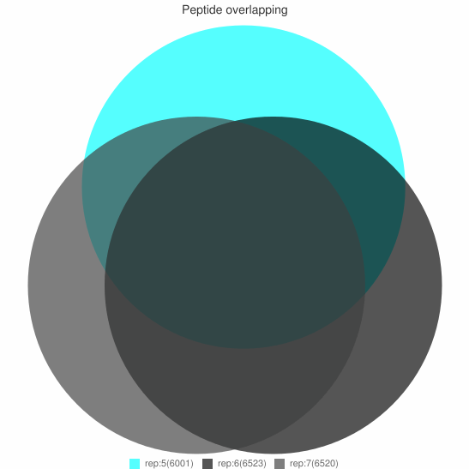
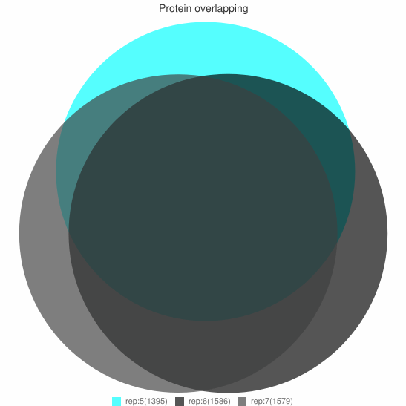
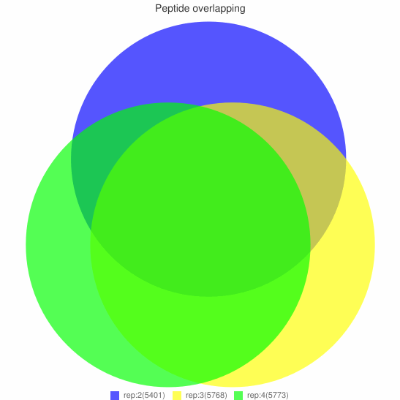
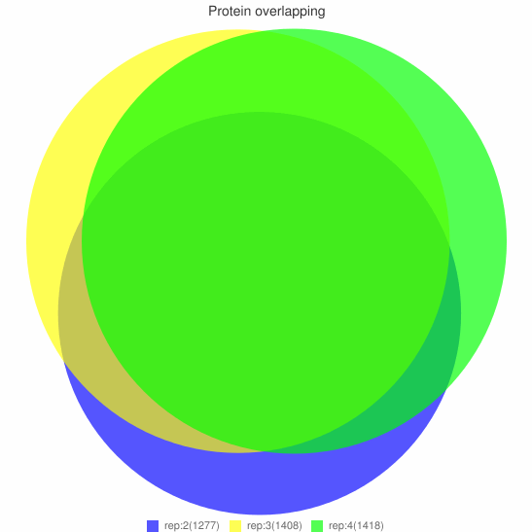
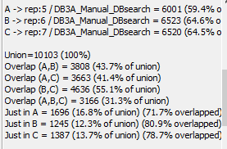
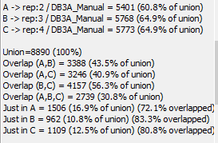
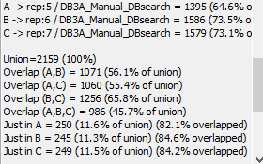
Visualization with PaCOM: overlap of proteins and peptides between replicates
Database search
31.3%
(3166)
45.7%
(986)

Slide 24
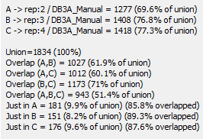
Visualization with PaCOM: overlap of proteins and peptides between replicates
Dual search
30.8%
(2739)
51.4%
(943)

Slide 25
A comparison of the reproducibility (at peptide and protein level) between original analysis and new analysis
 |  | Peptide overlap | Protein overlap
Reproduced results (IA) | Database search | 31.3% (3166) | 45.7% (986)
 | Dual search | 30.8% (2739) | 51.4% (943)
Fernández-Costa et al (OG) | Database search | 31.2% (3256) | 44.5% (974)
 | Dual search | 38.3% (3430) | 58.9% (948)
Peptide overlap
Protein overlap
31.3%
(3166)
45.7%
(986)
Database search
Dual search
30.8%
(2739)
51.4%
(943)

Slide 26
Next steps
Optimize reproducibility in manual search
Spectral library search → different filtering levels (protein vs peptide), SpectraST parameters
Recovery of old uniprot releases (?)
Reproducible workflow
Organize and set up Docker images (including how to run TPP from the container)
Translate optimized ‘manual’ bash scripts as nextflow processes
Potential extras
Quick stats summary → PaCOM venn diagrams statistics
Add parameter options for individual processes (not just database search parameters)
Nextflow tower GUI
Notes:
Without the exact uniprot file and small parameter details, I’m as happy as I can be with the reproduced results
The spectral library search though is probably user error though and I can explore that more

Slide 27
Thank you! Questions?

